Slide 1
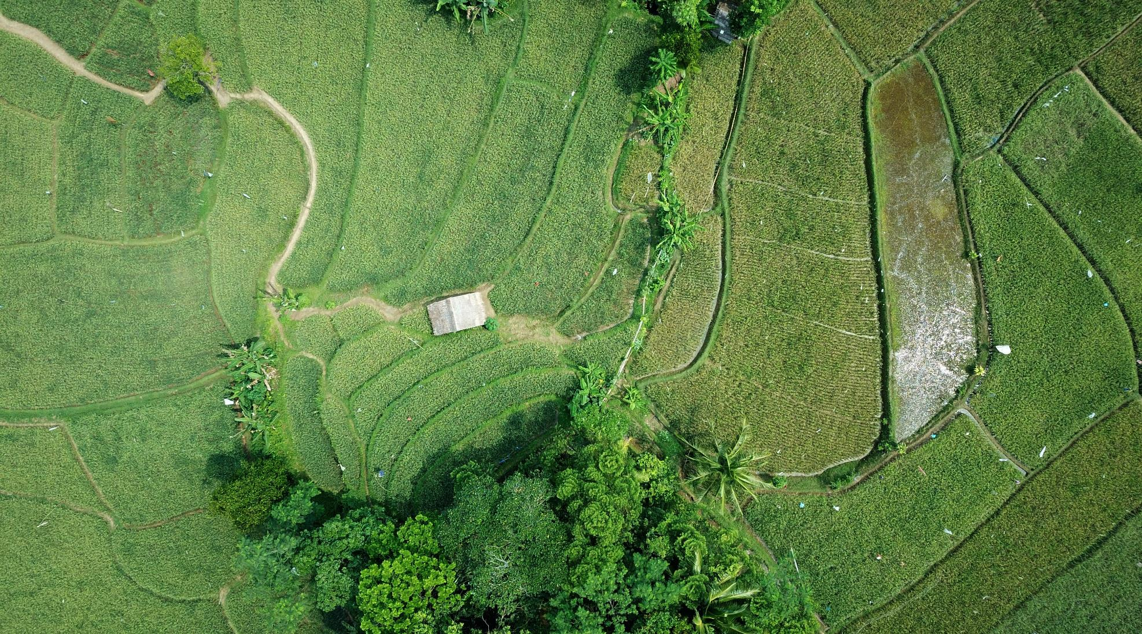
NEON AOP Data Science Intern Presentation: Standardizing and Visualizing QA Data
By Sydney Davis, August 2020

Slide 2
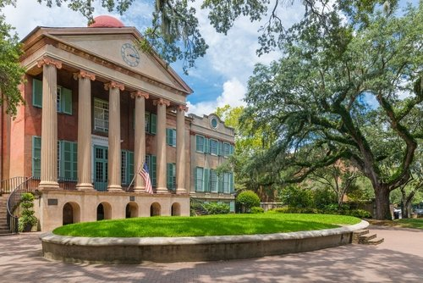

About Me
College of Charleston in Charleston, SC
Senior
Studying sociology, Russian, data science
Interest in NEON: coding, sustainability, data!
https://www.usnews.com/best-colleges/college-of-charleston-3428
https://blog.radissonblu.com/experiencing-spectacular-st-petersburg-in-spring/

Slide 3
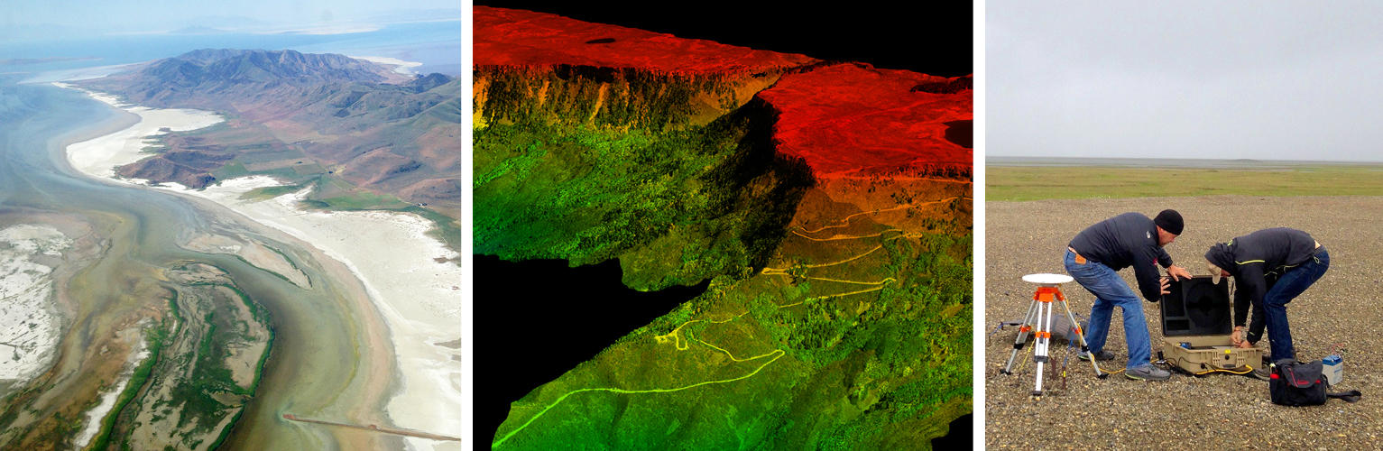
Project Overview
https://www.neonscience.org/assignable-assets/airborne-observation-platform
Overall goal:
Create a reproducible method for extracting and standardizing QA data
In more simple terms…
Help AOP team report statistics on the availability and validity of the different data products
How?
Python!

Slide 4
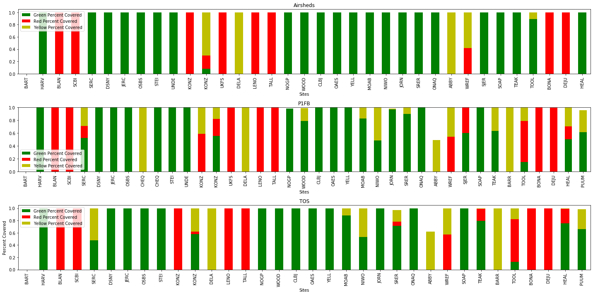
2019 Weather Percent Covered by Site and Boundary

Slide 5
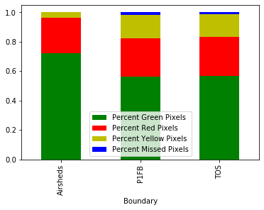
2019 Weather Coverage Summary Plots by Boundary
Percent

Slide 6
Other data products
Longest_Triangular_Edge_Ground_Point.tif and Longest_Triangular_Edge_All_Point.tif
We ran these and tweaked the code so it could accept a certain max threshold, which was 1 meter for both data products. We then calculated the percent of tifs, and pixels, in each flight boundary that were over and under the threshold
HorzUncertainty.tif and VertUncertainty.tif
We fed the functions a .58 and .15 meter threshold for each, respectively

Slide 7
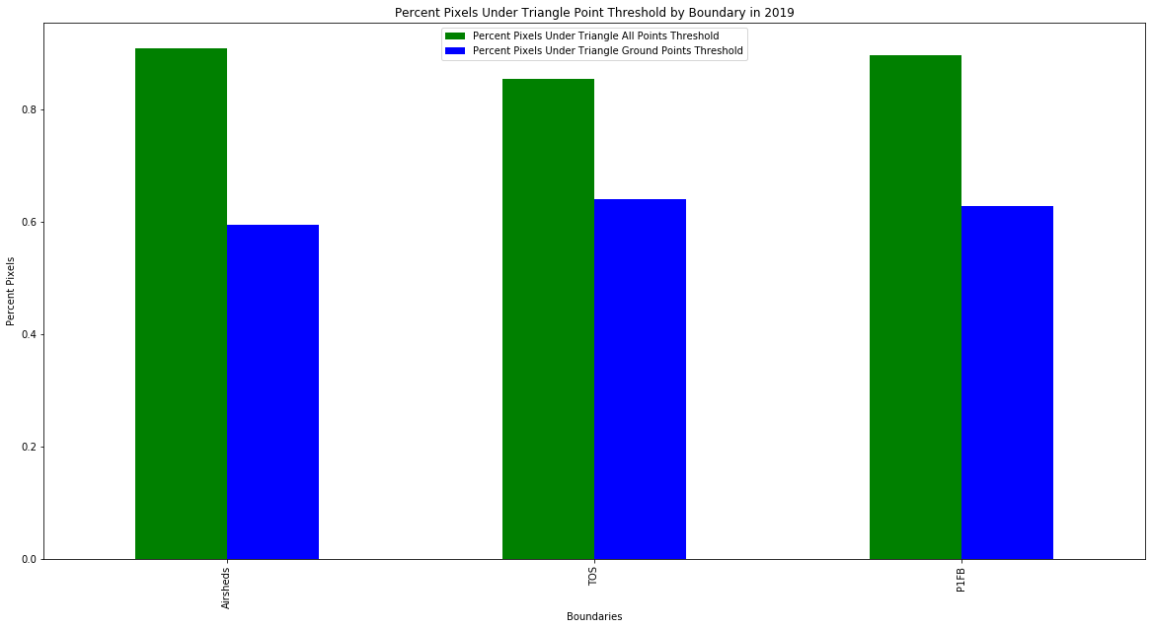
1.0-
1.0-

Slide 8
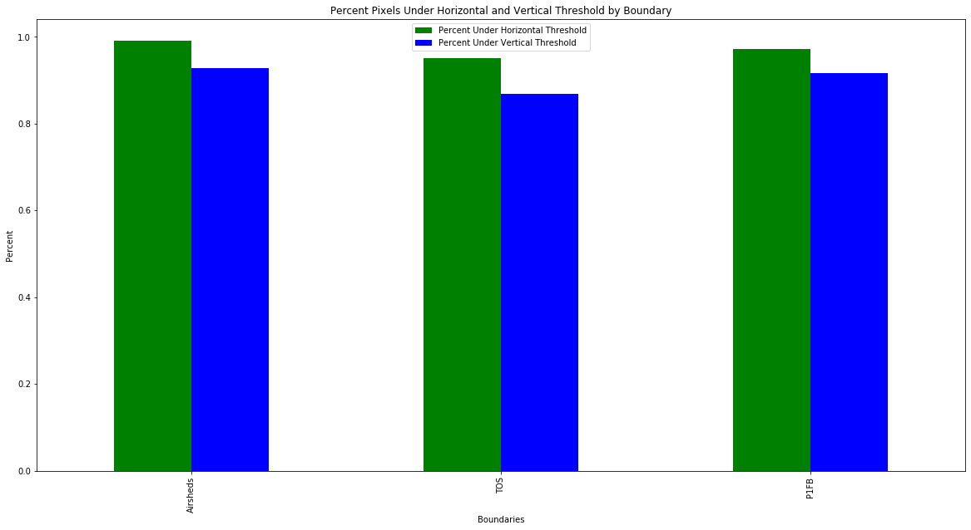


Slide 9
How does this project impact NEON’s AOP data output?
Standardizing QA on NEON’s AOP data reporting, comparable to USGS QA bands
Better accuracy in QA, given we analyzed the DPs down to the pixel-level
Best data can be pulled by looking at the plots once mosaiced together
Grants AOP team information for future planning
Separate webpage on QA for AOP data

Slide 10
Questions?

